Slide 1

BECOMING A BADASS PYTHON PROGRAMMER
`
A guide to being an exceptional Python programmer

Slide 2
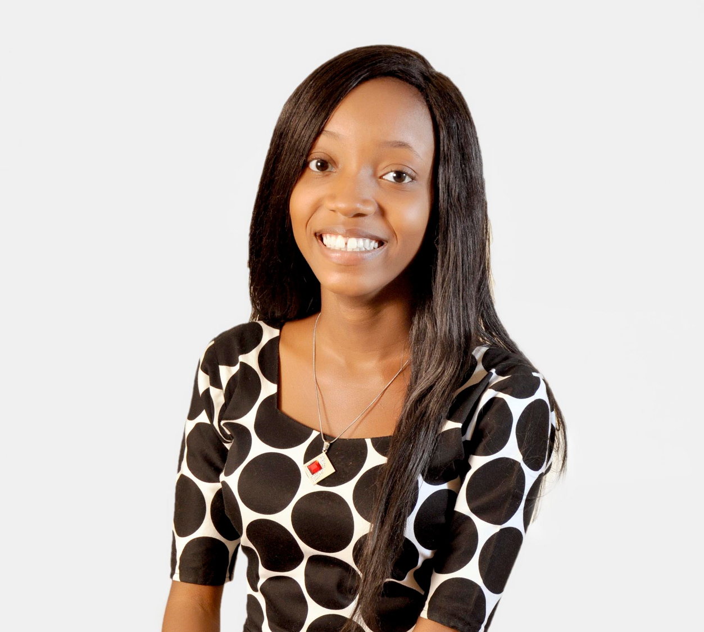
ABOUT SPEAKER
Data Scientist at Click-on Kaduna
Google Women TechMaker
Computer Science Student
SKILLS
Python
Power BI
SQL
Excel

Slide 3

OUTLINE
01
ROADMAP
02
TIPS & TRICKS
03
NETWORKING
Notes:
https://pixabay.com/photos/conference-room-table-office-768441/

Slide 4


ROADMAP
BASIC
INTERMEDIATE
ADVANCE
Data types and operators
Data structures
Control Flow
Functions and Classes(OOP)
Lambda Expressions
Iterators and Generators
Mini projects
Specialization
Web development
Data Science
Machine Learning

Slide 5
TIPS & TRICKS (TECH RELATED)
Grow your skillset
Build projects that interest you and others.
Join a community
Get a mentor
Read people’s code and documentation
5
1
2
4
3

Slide 6
TIPS & TRICKS (PERSONAL)
Start a tech blog
Be consistent in the right direction
Know yourself
Try open learning
Teach others
5
1
2
4
3

Slide 7


NETWORKING
ATTEND MEETUPS (ONSITE OR ONLINE)
LEVERAGE ON SOCIAL MEDIA
SHOOT YOUR PROFESSIONAL SHOTS
SHOWCASE YOUR WORK

Slide 8
ENJOY THE PROCESS
BE KIND TO YOURSELF

Slide 9



THANK YOU!
`
Connect with me
Jhoie__
Joy Victor

